Slide 1
OLYMPIC RECORD

Slide 2
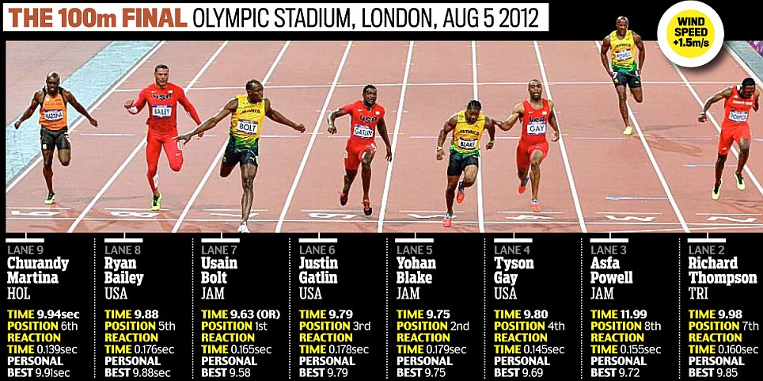
THEME

Slide 3
Table
01 Athlete
02 Events
03 Records
04 Country

Slide 4
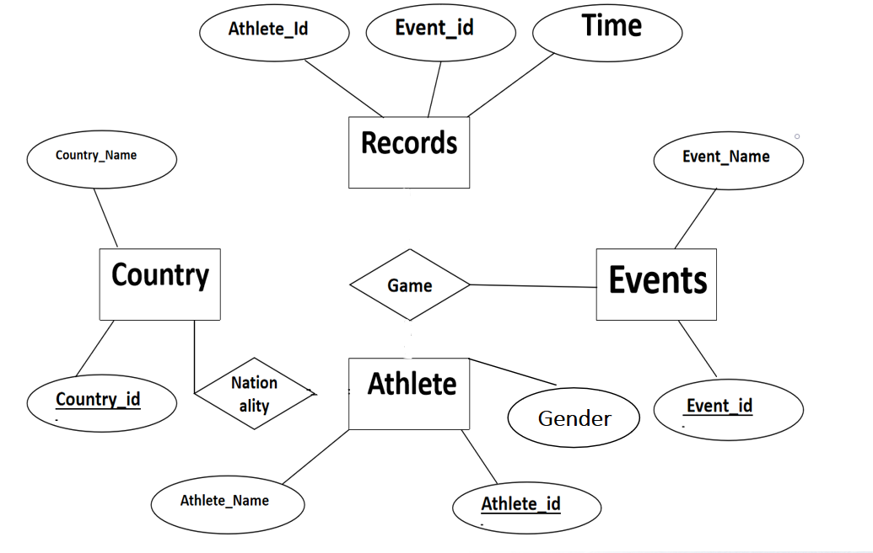
ER DIAGRAM

Slide 5
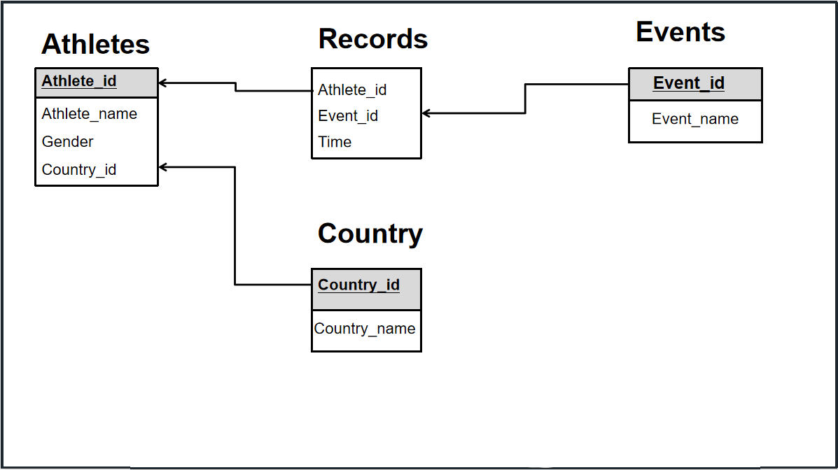
SCHEMA DIAGRAM

Slide 6
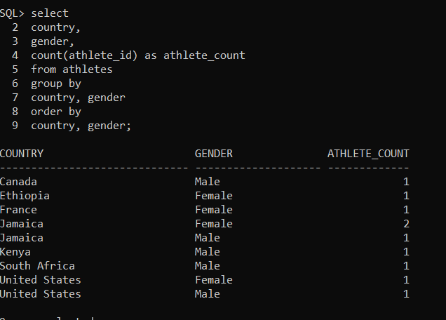

Slide 7
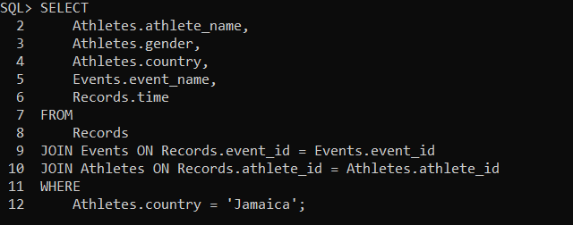


Slide 8
THANK YOU

